Slide 1
LIBRARY MANAGEMENT SYSTEM
Team:
Abhinay Kailas - 20071A1261
A Shiva Teja - 20071A1262
Anirudh Bukka - 20071A1263
A Abhishek Rao - 20071A1264
B Pravanthi - 20071A1265
Gopala Manaswini - 20071A1276
Gouni Pravallika - 20071A1277
Gummadavalli Dhanush - 20071A1278
Roshni - 21075A1211

Slide 2
ABSTRACT
The main ideology is to develop a completely automated, database driven galore of books to serve as a one stop solution for accessing various types of literatures. By making use of Database technologies such as ORACLE SQL, we aim to create a organised and hierarchical library structure, one which can also enable users to lend books.

Slide 3
INTRODUCTION
The phenomenal run of the e-commerce sector and the booming start-up ecosystem has today assumed an extremely vital role in our daily lives. It enhances our convenience by allowing us access to varied resources, all from the comfort of our home.
Books are one such commodity which is extremely vital to spread knowledge among the community. Books provide us with centuries of knowledge which can later be applied in our respective fields of life.
We therefore aim to merge the growing e-commerce market with the passion for spreading knowledge. Our project thereby, aims to create a library that is fully digital in nature, and can be accessed by any device that is connected to the internet. Users can then decide if they wish to purchase a book for complete ownership, or if they wish to just access a trial version of the book to get a feel for the same. The books will be segregated on the basis of various easy to understand factors such as author name, genre and popularity. To organize data, we will be using oracle DBMS, in association with SQL to execute queries and present to the user the product of their choice.

Slide 4
ENTITIES AND ATTRIBUTES
1) Library:
Name
timing
Staff no.
Books available
2) Books:
Book id
Author
Publisher
Subject/Genre
Year of Publication
Availability
3) Student:
SName
Book id
Id card
Issue date
Due date
4) Teacher:
TName
Book id
Card no.
Issue date
Due date
5) Librarian:
L.id
LName
Book id
Dob(age)

Slide 5
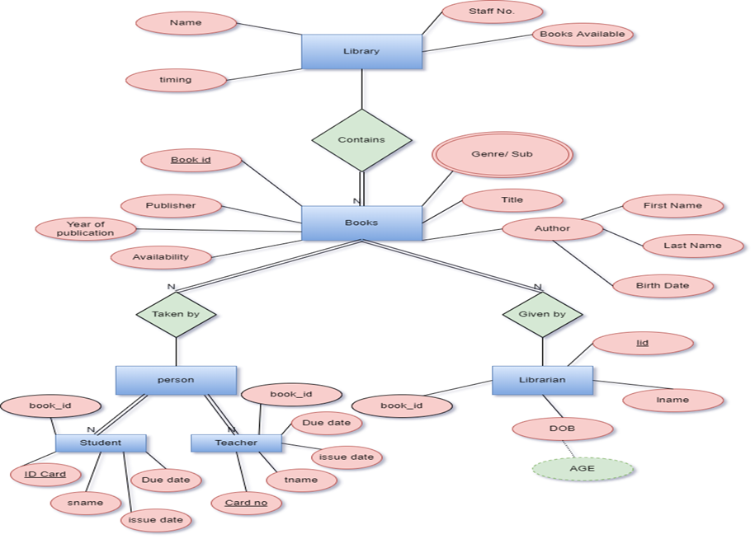
ENTITY RELATIONSHIP DIAGRAM

Slide 6

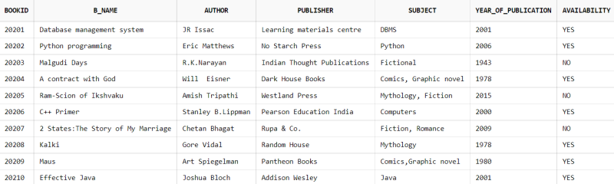
RELATIONAL MODEL
1)LIBRARY TABLE
2)Books Table

Slide 7
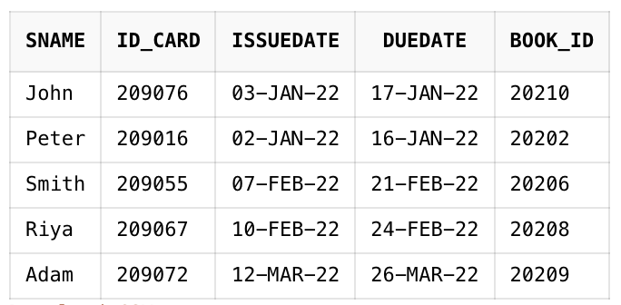
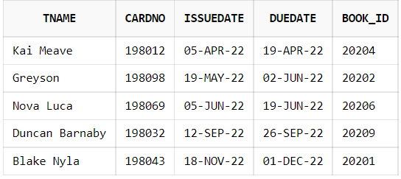
RELATIONAL MODEL
3)Student Table
4)Teacher table

Slide 8
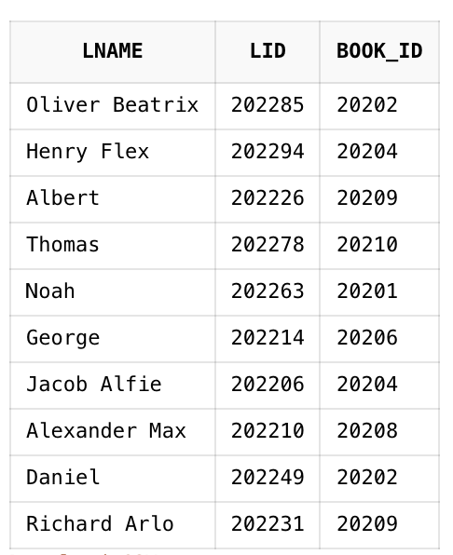
RELATIONAL MODEL
5)Librarian Table

Slide 9
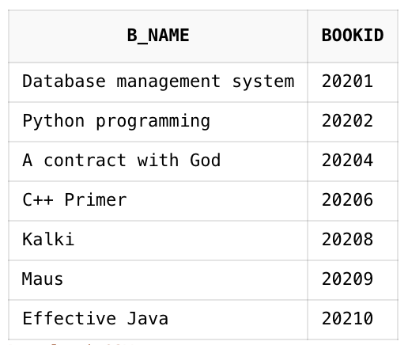
Query1 -
Display the books that are available.
select B_NAME, BOOKID
from BOOKS
where AVAILABILITY = 'YES';

Slide 10
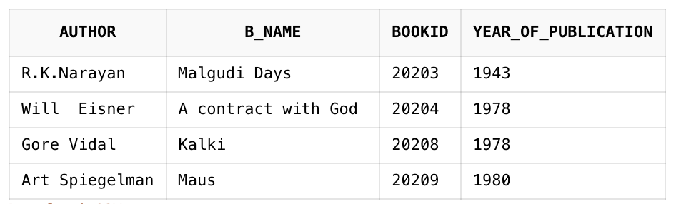
Query2 -
Display Authors' names whose Year of publication is before 2000.
select AUTHOR, B_NAME, BOOKID, YEAR_OF_PUBLICATION
from BOOKS
where YEAR_OF_PUBLICATION < 2000;

Slide 11
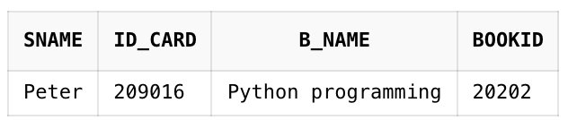
Query3 -
Display the Students' names who took the book "Python programming".
select s.sname, s.id_card, b.b_name, b.bookid
from student s, books b
where b.b_name = 'Python programming' and s.book_id = 20202;

Slide 12
CONCLUSION
To summarize and conclude, in this course based project, we created a Library management based environment for users to seamlessly interact with books of different kinds, from varied authors, publishers and genres. Furthermore, we have also given them a large variety of options in terms of book ownership, to complete unilateral ownership of the book. Throughout the project, we have made use of concepts taught to us, including DDL, DML commands, Primary Keys e.t.c. We have built the database from the ground up, starting from the basic ER – Diagram, all the way to a complete, well defined, well structured database schema. Furthermore, to practically show the usage of the database, a large number of sample queries for each and every entity based tables have been provided. We believe that a model like ours can be implemented seamlessly in order to make the experience of reading pleasurable and comfortable to the end user.

